Slide 1

DM & ML Industrial Strength Algorithms
Gergely Lukács
Pázmány Péter Catholic University
Faculty of Information Technology and Bionics
Budapest, Hungary
lukacs@itk.ppke.hu

Slide 2
Industrial-strength algorithms
Requirements for an algorithm to be useful in a wide range of real-world applications
Is robust in the presence of noise (avoids overfitting)
Can deal with numeric attributes
Doesn’t fall over when missing values are present
Scalable
Basic schemes need to be extended to fulfil these requirements
2

Slide 3
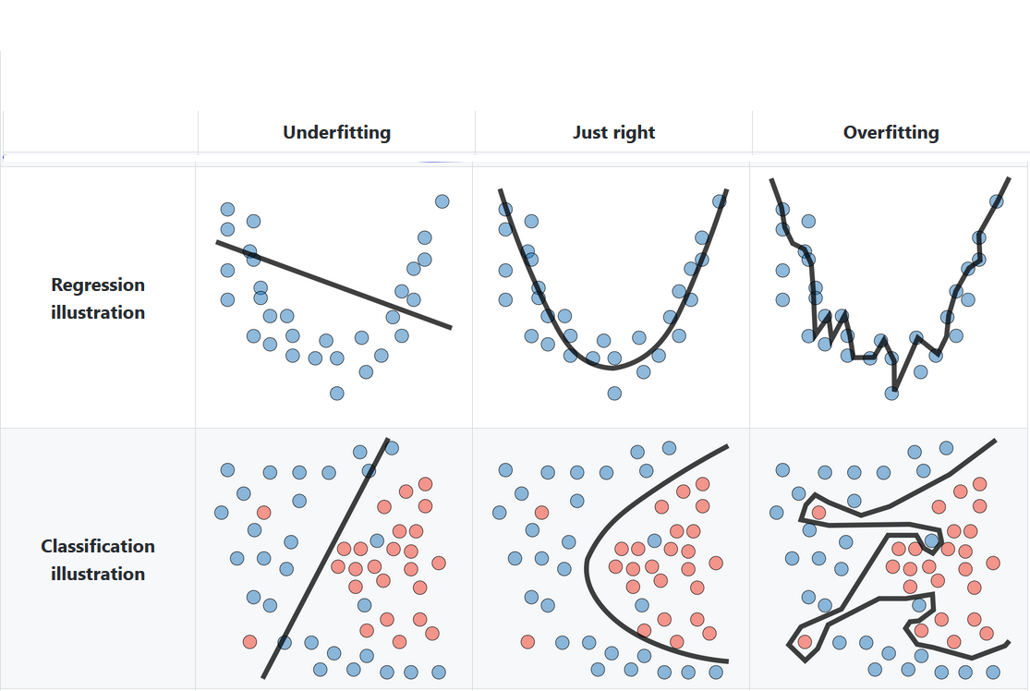
Underfitting, overfitting
Data: underlying pattern („concept”) + noise
Goal: describe pattern, ignore noise
generalizes well to unseen data
Two possible problems:
3

Slide 4
Underfitting, overfitting
generalize badly
did not learn pattern (well)
overly simple model
represent training set badly
bad performance on unseen data
generalize badly
learned noise
overly complex model
represent training set well
bad performance on unseen data
4

Slide 5
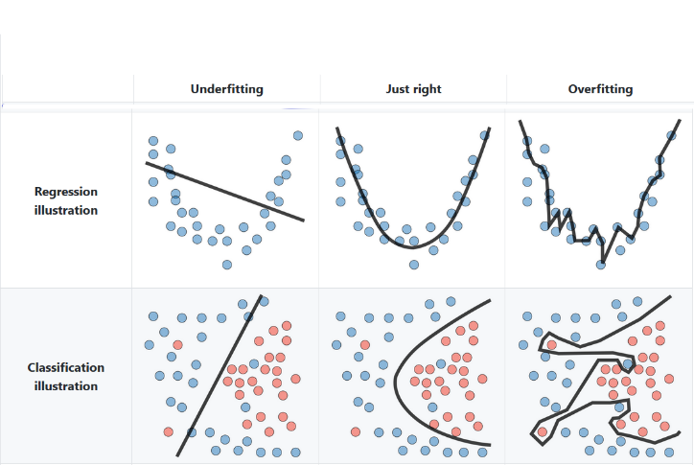
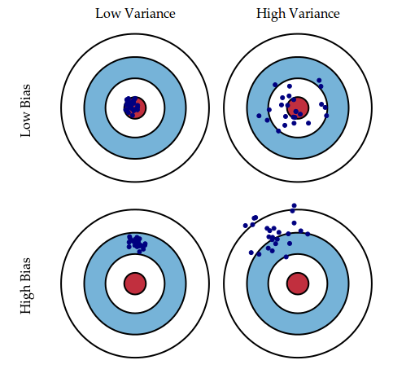
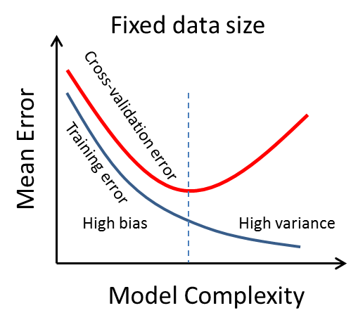
Bias, variance
Illustrating predictions
High bias
High variance
5

Slide 6
Decision trees, C4.5

Slide 7
Decision trees
Extending ID3
numeric attributes: pretty straightforward
missing values: a bit trickier
stability for noisy data: requires sophisticated pruning mechanism
End result of these modifications: C4.5 (Weka: J48)
Best-known and (probably) most widely-used learning algorithm

Slide 8
Numeric attributes
Standard method: binary splits (e.g. temp < 45)
Difference to nominal attributes: every attribute offers many possible split points
Solution is straightforward extension:
Evaluate info gain (or other measure) for every possible (!!!) split point of attribute
Choose “best” split point
Info gain for best split point is info gain for attribute
Select attribute – nominal or numeric – with highest info gain for node

Slide 9
Numeric attributes: An example
Split on temperature attribute from weather data:
Split points are placed halfway between values
E.g. 71.5 4 „yes”es and 2 „no”s for temperature < 71.5, 5 „yes”es and 3 „no”s for temperature ≥ 71.5
Info([4,2],[5,3]) = (6/14)info([4,2]) + (8/14)info([5,3]) = 0.939 bits
Calculation for all (!) split-points, selecting best split-point
64 65 68 69 70 71 72 72 75 75 80 81 83 85
Yes No Yes Yes Yes No Yes No Yes Yes No Yes Yes No

Slide 10
(Numeric attributes: efficient execution)
Instances need to be sorted according to the values of the numeric attribute considered
All split points can be evaluated in one pass!
Does sorting have to be repeated at each node?
No! Sort order from parent node can be used to derive sort order for children
Only drawback: need to create and store an array of sorted indices for each numeric attribute

Slide 11
Numeric attributes: Notes on binary splits
Information in nominal attributes is exhausted using one multi-way split on that attribute
Nominal attribute is tested (at most) once on any path in the tree
This is not the case for binary splits on numeric attributes
The same numeric attribute may be tested several times along a path in the decision tree
Disadvantage: tree is relatively hard to read
Possible remedies:
pre-discretization of numeric attributes
multi-way splits instead of binary ones

Slide 12
Missing values
Training
C4.5 splits instances with missing values into pieces
a piece going down a particular branch receives a weight proportional to the popularity of the branch
weights summing to 1
Info gain etc. can be used with fractional instances using sums of weights instead of counts
Classification
the same procedure is used to split instances into pieces
results are merged using weights

Slide 13
Tree overfitting
ID3 stop criterion
Leaf node pure
No more attribute to select
Tends to overfit
Lower levels (close to leaf nodes) decided on small number of training instances

Slide 14
Pruning
Simplifying decision tree to prevent overfitting
Postpruning: takes a fully-grown decision tree and discards unreliable parts
Prepruning: stops growing a branch when no further improvement (information becomes unreliable)

Slide 15
Prepruning
Usually based on statistical significance test
Stops growing the tree when there is no statistically significant association between any attribute and the class at a particular node
Problem: early stopping: may stop the growth process prematurely
Classic example: XOR/Parity-problem
No individual attribute exhibits any significant association to the class
Structure is only visible in fully expanded tree
Prepruning won’t expand the root node
But: XOR-type problems not common in practice
Prepruning faster than postpruning

Slide 16
Postpruning
Problem: some subtrees might be due to chance effects/noise
First, build full tree
Then, prune (=simplify) it
Fully-grown tree shows all attribute interactions
Postpruning preferred in practice because of early stopping in prepruning

Slide 17
Postpruning in C4.5: pruning operations, pruning strategy
Pruning operations: How to simplify the tree
Subtree replacement
Subtree raising
Pruning strategy: When to apply a pruning operation
error estimation

Slide 18
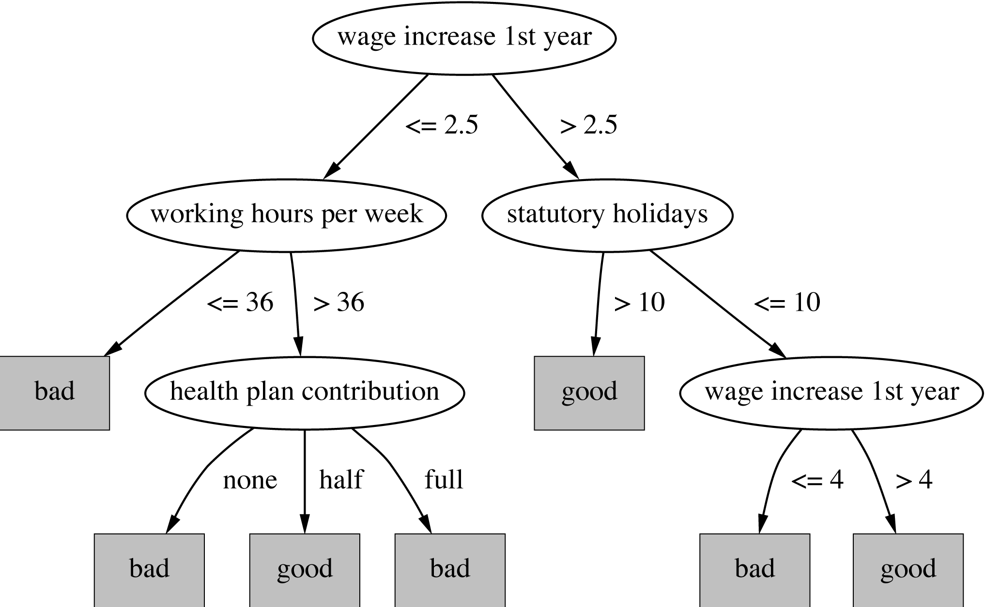
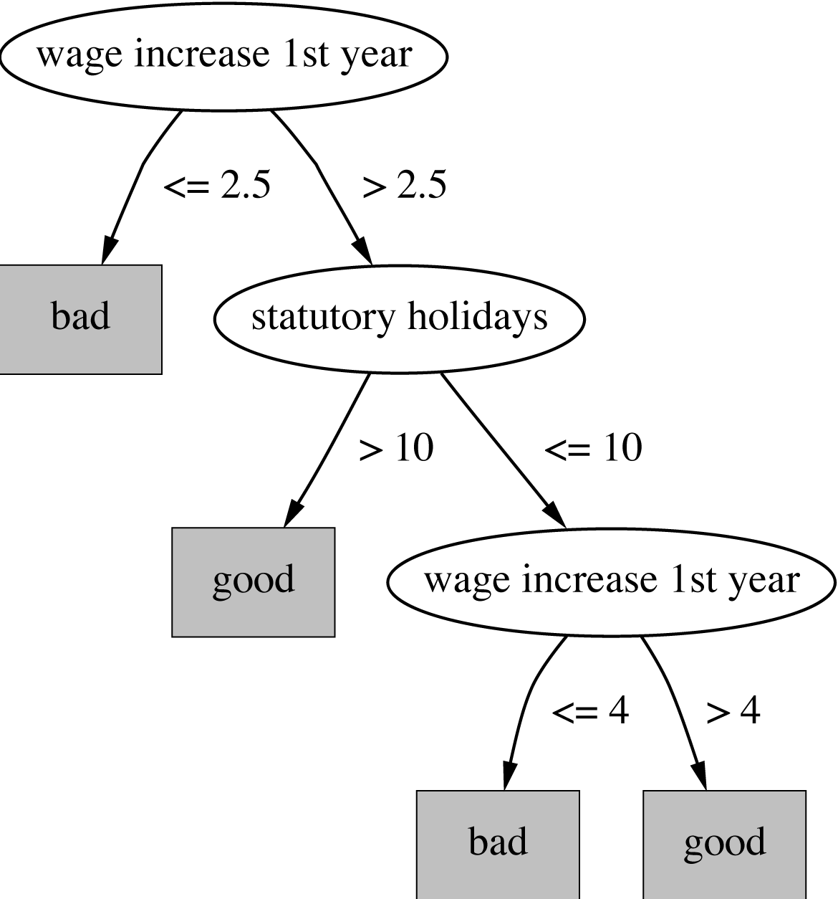
Pruning operation: Subtree replacement
Select some subtree and replace it with single leaf
Bottom-up: tree is considered for replacement once all its subtrees have been considered

Slide 19
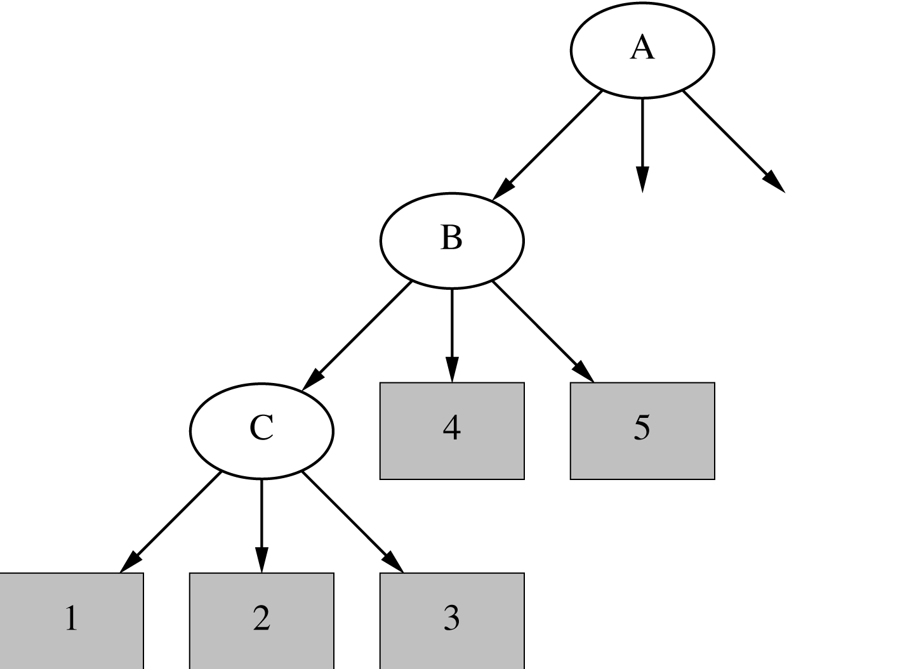
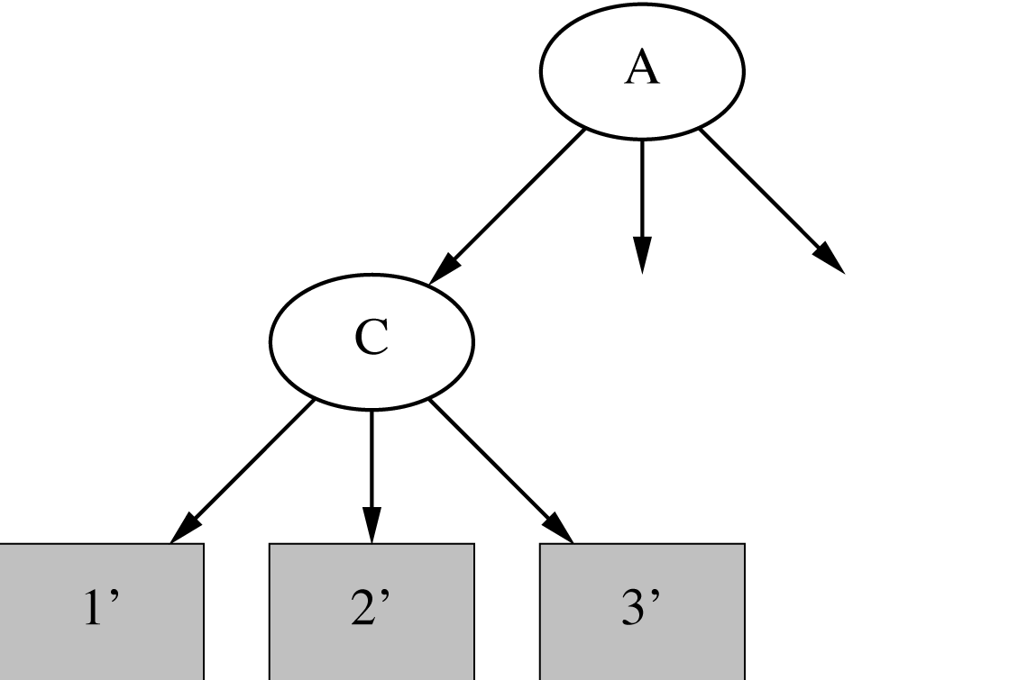
Pruning operation: Subtree raising
Deletes node and redistributes instances
Slower than subtree replacement
Is it useful? C4.5 does it that way

Slide 20
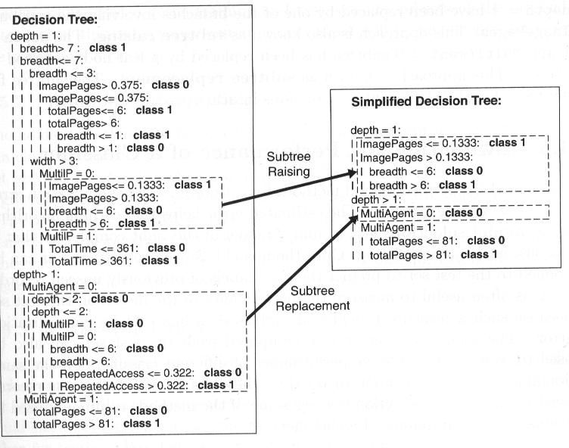
Postpruning Example

Slide 21
Pruning strategy: Estimating error rates
Prune only if it does not increase the estimated error
Methods
Error on the training data is NOT a useful estimator (would result in almost no pruning)
Use hold-out set (validation set) for pruning
Disadvantage: amount of data used for tree construction smaller
C4.5’s method
Derive confidence interval from training data
(Also considers amount of training data at this point in the tree)
Use a heuristic limit, derived from this, for pruning
Standard Bernoulli-process-based method
Shaky statistical assumptions (based on training data)

Slide 22
C4.5’s method
Error estimate for subtree is weighted sum of error estimates for all its leaves
Error estimate for a node:
f: error on the training data
N: the number of instances covered by the leaf
z: related to confidence level
If c = 25% (c: parameter of C4.5) then z = 0.69 (from normal distribution)

Slide 23
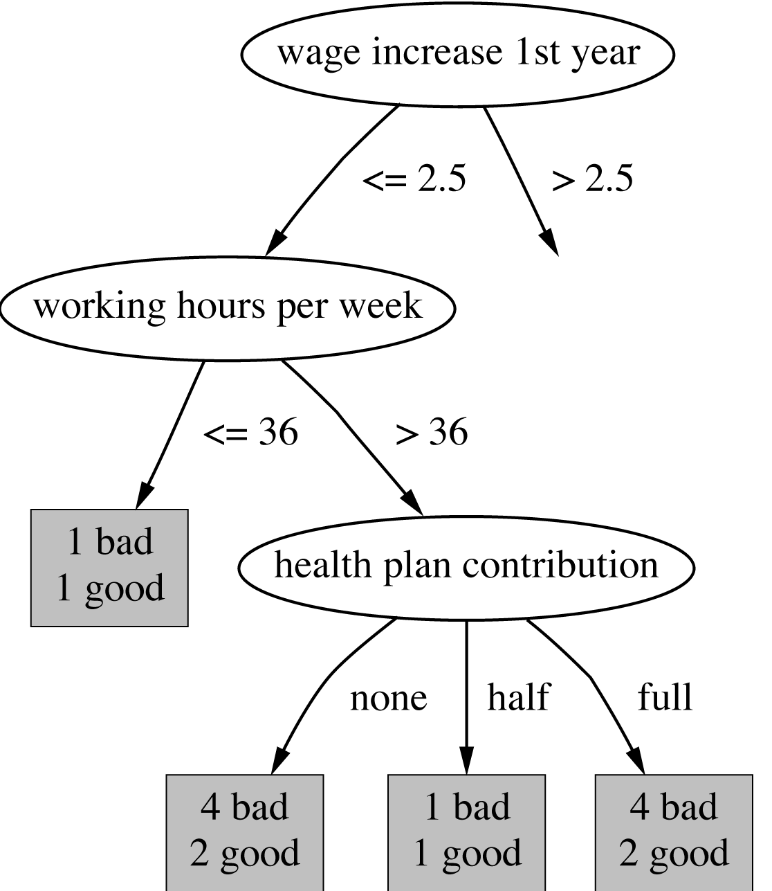
Example
Example
f = 5/14 e = 0.46 e < 0.51 so prune!
f=0.33 e=0.47
f=0.5 e=0.72
f=0.33 e=0.47
Combined using ratios 6:2:6 gives 0.51

Slide 24
C4.5: choices and options
C4.5 can be slow for large and noisy datasets
C4.5 offers two parameters
the confidence value (default 25%): lower values incur heavier pruning
a threshold on the minimum number of instances in the two most popular branches (default 2)

Slide 25
CART (Classification and Regression Trees)
Breiman, Friedman, Olshen, Stone, 80’s.
Gini index
Cost-complexity postpruning
…
Handles outliers
Binary trees

Slide 26
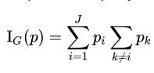
GINI Impurity
how often a randomly chosen element from the set would be incorrectly labeled if it was randomly labeled according to the distribution of labels in the subset
J classes
p_{i} fraction of items labelled with i in the set

Slide 27
Cost-complexity pruning
Error relative to size of subtree
Increase in error (α): average error increase per leaf of subtree
Pruning generates a sequence of successively smaller trees
Each candidate tree in the sequence corresponds to one particular threshold value, α_{i}
Which tree to choose as the final model?
Use either a hold-out set or cross-validation to estimate the error of each

Slide 28
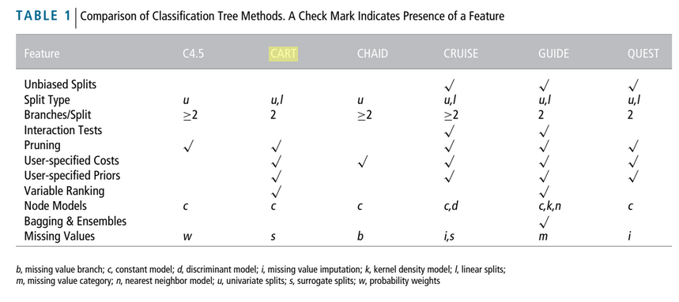
(Comparison of Classification Tree Methods)

Slide 29
Discussion
Top-down induction of decision trees is probably the most extensively studied method of machine learning used in data mining
Different criteria for attribute/test selection rarely make a large difference
Different pruning methods mainly change the size of the resulting pruned tree
C4.5 builds univariate decision trees (one attribute per test)
Some systems (e.g. CART) can build multivariate trees (more than one attributes per test allowed)

Slide 30
Regularized linear regression

Slide 31
Regularization
discourages learning a more complex or flexible model, so as to avoid the risk of overfitting.
minimizing error on data + complexity of model

Slide 32
Ridge Regression
Ordinary Linear Regression
Minimizes Least Square of Error, LS
Ridge regression
Minimization objective = LS + α * (sum of square of coefficients)
L2 regularization
alpha >=0: complexity parameter

Slide 33
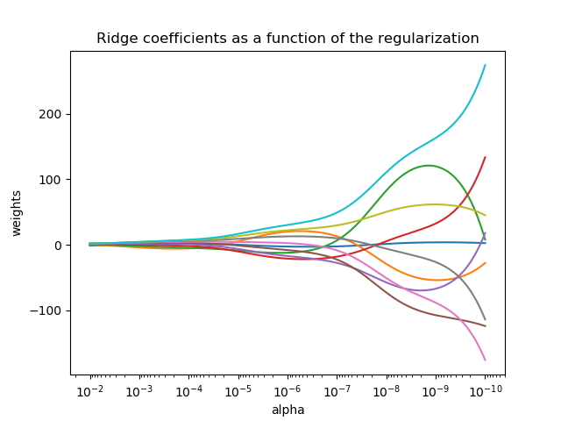
Ridge Regression 2
α>=0: complexity parameter controls amount of „shrinkage”: the larger, the greater the amount of „shrinkage”
Cross validation
Coefficients become also more robust to collinearity

Slide 34
Multicollinearity
Input variables that are correlated with other input variables in the model
Coefficient estimates are unstable
Doesn’t affect the overall fit of the model or produce bad predictions but interferes in determining the precise effect of each input variable

Slide 35
Lasso regression
Lasso: Least Absolute Shrinkage and Selection Operator
Minimization objective = LS + α * (sum of absolute value of coefficients)
L1 regularization
Prefers solutions with fewer parameter values, reducing the number of variables

Slide 36
Ridge vs Lasso
model complexity reduction
overfitting prevention
Ridge:
exorbitantly high #features (~ millions): computational challenges
highly correlated features OK (includes all)
Lasso:
shrinking coefficients+ feature selection as well (coefficients become exactly zero)
#features are in millions or more
highly correlated features: arbitrary selection

Slide 37
Instance Based Learning, (Nearest Neighbour)

Slide 38
Problem 0: Different Attribute Domains
(some) normalisation of attributes!

Slide 39
Problem 1: slow predictions (+ storage place)
Solutions
Data structure: multidimensional tree
kD tree
Ball tree
Do not store all instances
saves memory, speeds up classification
Simple approach: Incremental model building, only incorporating misclassified instances has problems:
noisy data gets incorporated
discarding instances too early

Slide 40
Problem 2: noisy data
Solutions
k-NN
Voting (averaging)
selection of K?
the more noise, the larger k
Cross-validation for good k
Weighing with distance
Radius-neighbors (for non-uniformly sampled data)
Ignore or remove noisy instances Monitoring performance of instances
Two thresholds: ignoring for predictions, discarding

Slide 41
Problem 3: All attributes equally important?
Solutions
attribute selection (s. later; irrelevant attributes!)
attribute weighting
Euclidean d. w. weights:
Updating of weights based on nearest neighbor
Class correct/incorrect: weight increased/decreased
|x_{i}-y_{i}| small/large: weight change large/small
Class specific weights
weights, weighing per class
can result in unclassified instances and multiple classifications

Slide 42
Problem 4: Black box
Solution
Rectangular generalisations
In fact: hybrid representation
Rectangulars: rules
Outside of rectangulars: nearest-neighbour

Slide 43
Discussion
Simple method
No generalisation
Often good predictions!
irregular, flexible decision boundary

Slide 44
Numeric prediction with local linear models

Slide 45
Numeric prediction
45
Counterparts exist for (almost all) classification algorithms
All classification algorithms can be applied to regression problems using discretization (almost)
Prediction: weighted average of intervals’ midpoints (weighted according to class probabilities)
Regression more difficult than classification (i.e. percent correct vs. mean squared error)

Slide 46
Regression trees
46
Leaf node predicts average values of training instances reaching that node
Easy to interpret

Slide 47
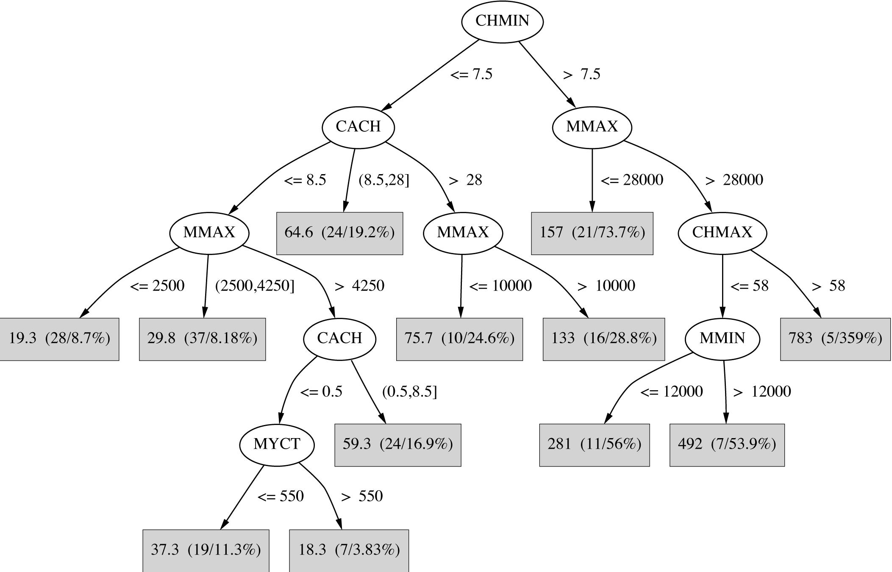
Regression tree for the CPU data
47
Notes:
47

Slide 48
Building the tree
Splitting criterion: standard deviation reduction
minimizing intra-subset variation
Termination criteria (important when building trees for numeric prediction):
Standard deviation becomes smaller than certain fraction of s. d. for full training set (e.g. 5%)
Too few instances remain (e.g. less than four)
Pruning criterion: based on numeric error measure
48

Slide 49
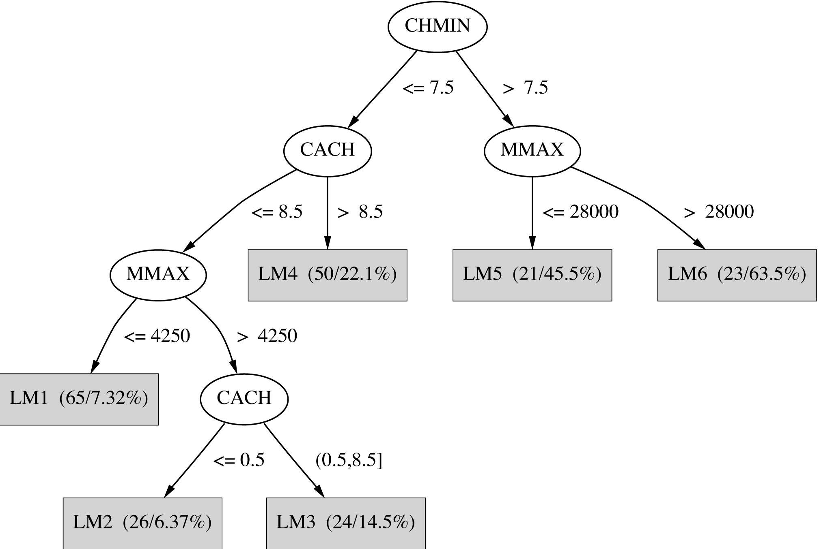
Model tree for the CPU data
Regression trees with linear regression formulas (models) at each node
49
Notes:
49

Slide 50
Linear Regression Functions
50
LM1 PRP = 8.29 + 0.004 MMAX + 2.77 CHMIN
LM2 PRP = 20.3 + 0.004 MMIN – 3.00 CHMIN
+ 0.946 CHMAX
etc.

Slide 51
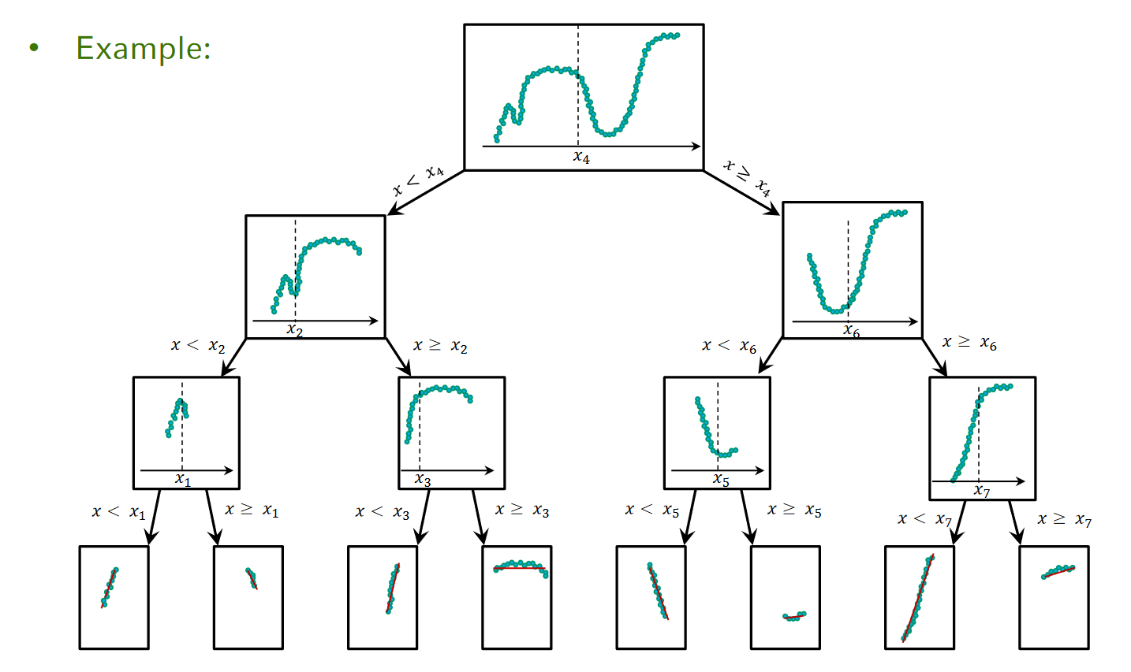
(Example (bit special): single input attribute, binary splits)

Slide 52
Building model trees
52
Linear regression applied to instances that reach a node after full regression tree has been built
Only a subset of the attributes is used for LR
Attributes occurring in subtree (+maybe attributes occurring in path to the root)
Fast: overhead for LR not large because usually only a small subset of attributes is used in tree

Slide 53
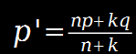
Smoothing
Smoothing: factor in ancestor’s predictions
Smoothing formula:
Same effect can be achieved by incorporating ancestor models into the leaves
Need linear regression function at each node

Slide 54
Pruning
54
Pruning is based on estimated absolute error of LR models
Model trees allow for heavy pruning: often a single LR model can replace a whole subtree
Pruning proceeds bottom up: error for LR model at internal node is compared to error for subtree

Slide 55
Nominal attributes
55
Nominal attributes are converted into binary attributes (that can be treated as numeric ones)
Nominal values are sorted using average class values
If there are k values, k-1 so-called synthetic binary attributes are generated
The ith binary attribute is 0 if an instance’s value is one of the first i in the ordering, 1 otherwise

Slide 56
Support Vector Machine (SVM)

Slide 57
Support vector machines
Find a linear hyperplane (decision boundary) that will separate the data
57
Support vector machines are algorithms for learning linear classifiers (for binary classification)

Slide 58
Many linear decision boundaries
Which one is better? B1 or B2?
How do you define better?
58

Slide 59
Maximum Margin Hyperplane
Find hyperplane maximizes the margin => B1 is better than B2
Maximum margin hyperplane
59

Slide 60
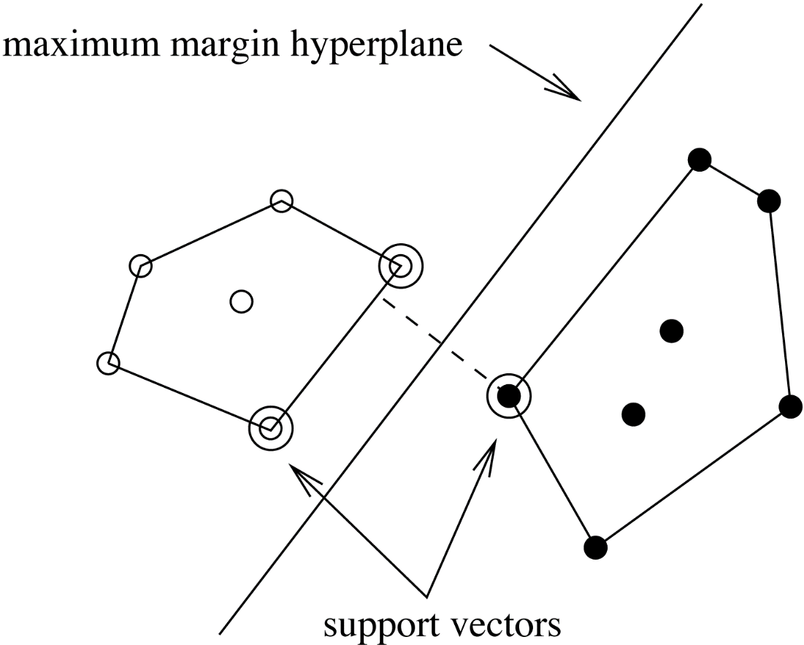
Support Vectors
Only a few instances are important for the maximum margin hyperplane: the closest ones
Those are called support vectors
All other instances can be deleted without changing the decision boundary
60

Slide 61
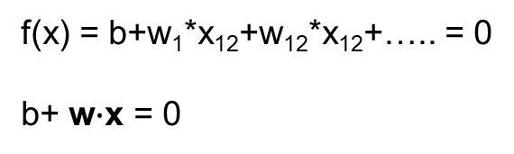
Finding the Maximum Margin Hyperplane
f(x) = +1
f(x) = 0
„+”
f(x) = -1
Decision rule:
b+ w ∙ x > 0 then „+”
b+ w ∙ x < 0 then „-”
x₂
Scale invariant, fixing scale: for support vectors: -1, +1
„-”
x₁
Class „+”
Class „-”

Slide 62
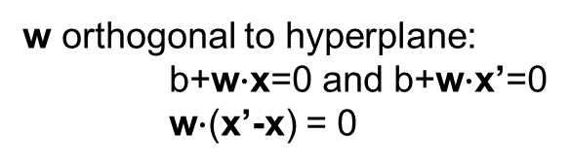
Margin width 1
f(x) = b+ w*x= 0
f(x) = +1
f(x) = 0
f(x) = -1
x₂
x’
x
w
x₁
Class „+1”
Class „-1”

Slide 63
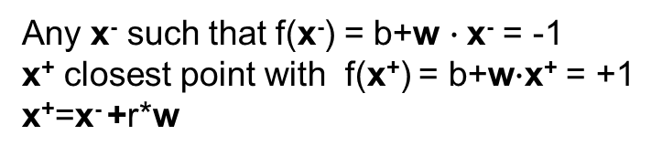
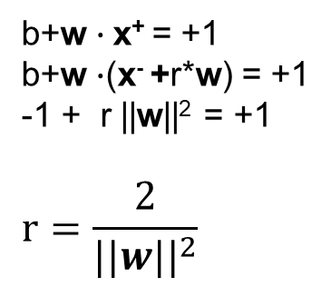
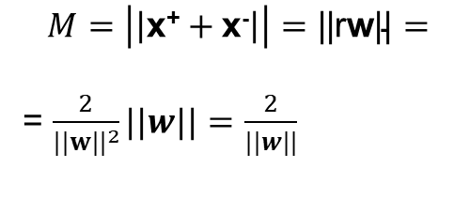
Margin width 2
f(x) = +1
f(x) = 0
f(x) = -1
x₂
x⁺
w
x⁻
M
x₁
Class „+”
Class „-”

Slide 64
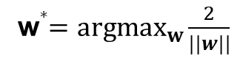
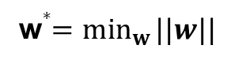
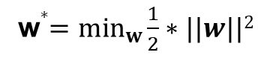
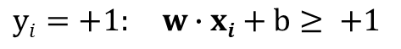
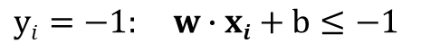
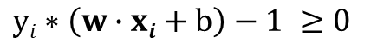
Maximum Margin
f(x) = +1
f(x) = 0
Such that m (number of instances) constraints satisfied:
f(x) = -1
x₂
Compact form of all constraints:
x⁺
w
x⁻
M
Primal problem
Constrained quadratic optimization
x₁
Class „+1”
Class „-1”

Slide 65
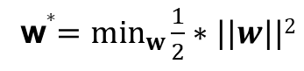
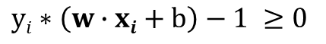
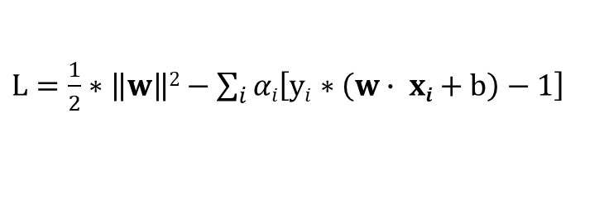
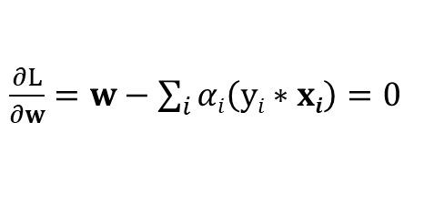
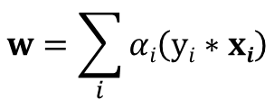
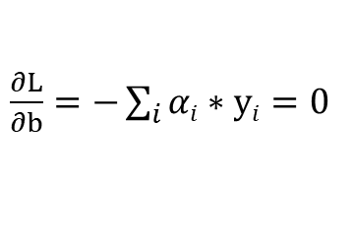
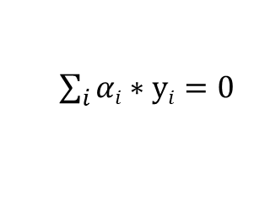
Lagrangian optimization
with constraints
Lagrange multiplier: searching the extreme value of some function under some constraints ->
searching the extreme value (no constraints)

Slide 66
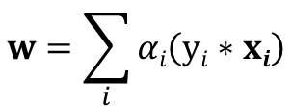
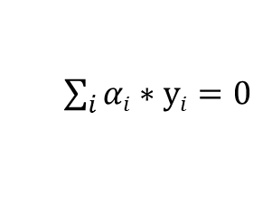
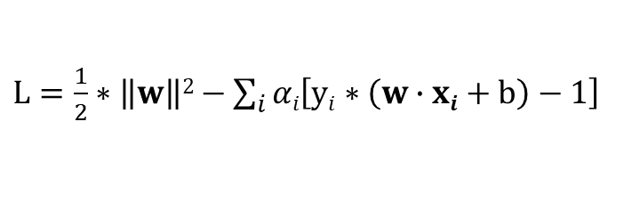
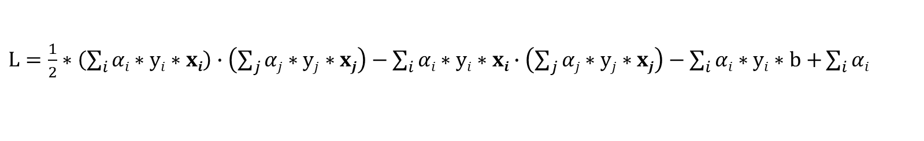
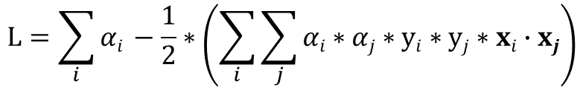
Lagrangian optimization
Extreme value search of this.
Lagrangian dual of original problem
Optimization only depends on dot products of pairs of instances!!!
Number of dimensions: number of instances (original: number of attributes) – will become important for nonlinear case
No local extreme values: optimal parameters can be found!

Slide 67
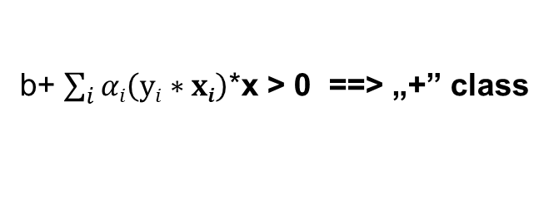
Decision Rule transformed
b+ w ∙ x > 0 ==> „+” class
Decision rule also only depends on dot product!
„Everything” depens only on the dot products!!!

Slide 68

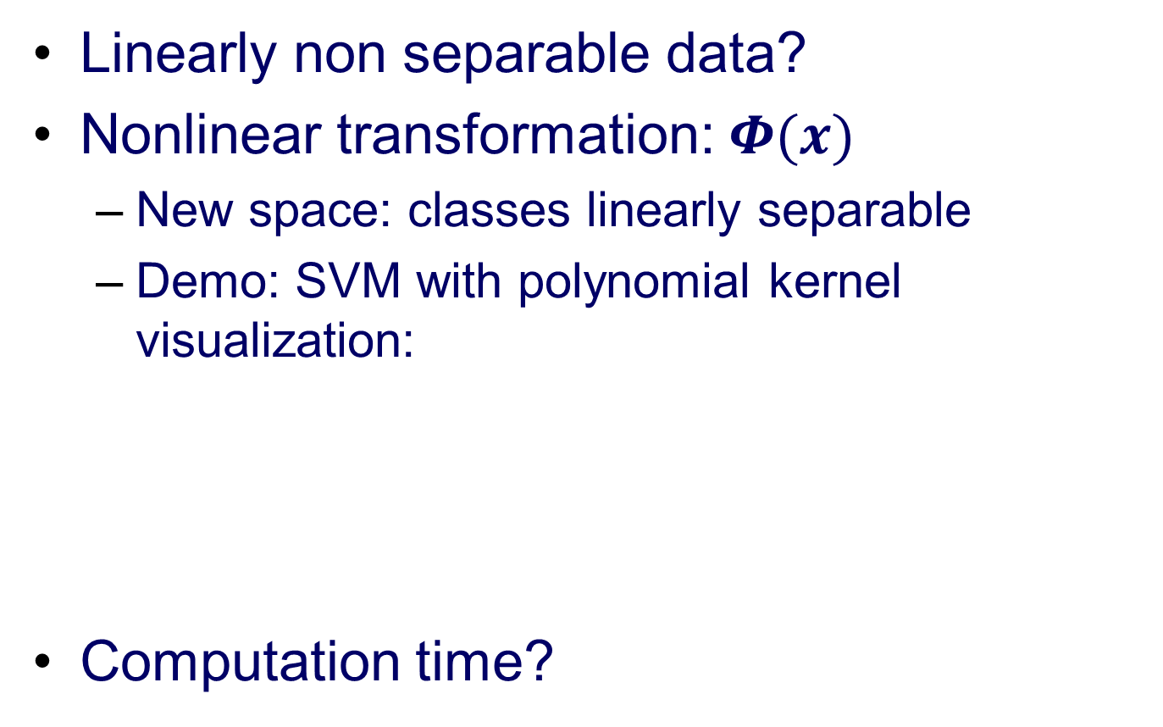
Nonlinear SVMs
68

Slide 69
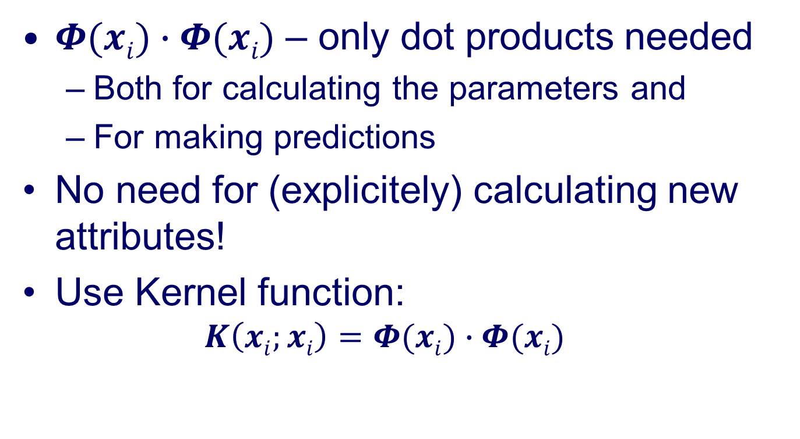
Kernel trick
$Φ(xi)∙Φ(xi)$ – only dot products needed
Both for calculating the parameters and
For making predictions
No need for (explicitely) calculating new attributes!
Use Kernel function:
$$K\left(xi;xi\right)=Φ(xi)∙Φ(xi)$$

Slide 70
Kernel Functions
Polynomial kernel
How to select kernel for SVM?
https://stats.stackexchange.com/questions/18030/how-to-select-kernel-for-svm
Prior, expert knowledge (automatic selection, tuning: very easy to overfit!)
70

Slide 71
Noise
71
Have assumed that the data is separable (in original or transformed space)
Few noisy instances can cause big problems!
Can apply SVMs to noisy data by introducing a regularization parameter C
C bounds the influence of any one training instance on the decision boundary
Corresponding constraint: 0 =< α_{i} =< C
Still a quadratic optimization problem
Have to determine C by experimentation

Slide 72
Advantages
maximizes margin: (some) robustness
support for kernels – computable approach for nonlinear problems
regularization parameter to reduce overfitting
Kernel: you can build in expert knowledge about the problem via engineering the kernel
SVM is defined by a convex optimization problem (no local minima) for which there are efficient methods (e.g. SMO).

Slide 73
Disadvantages
choosing kernel function?
hyperparameter selection for avoiding overfitting?
high algorithmic complexity and extensive memory requirements of the required quadratic programming in large-scale tasks

Slide 74
Sparse data
74
SVM algorithms speed up dramatically if the data is sparse (i.e. many values are 0)
lots and lots of dot products: for sparse data very efficient, iterate only over non-zero values
SVMs can process sparse datasets with 10,000s of attributes

Slide 75
Applications
75
Machine vision: e.g face identification
Outperforms alternative approaches (1.5% error)
Handwritten digit recognition: USPS data
Comparable to best alternative (0.8% error)
Bioinformatics: e.g. prediction of protein secondary structure
Text classifiation

Slide 76
Support vector regression
76
Maximum margin hyperplane only applies to classification
However, idea of support vectors and kernel functions can be used for regression
Basic method same as in linear regression: want to minimize error. Differences
ignore errors smaller than ε (user specified parameter)
use absolute error instead of squared error
simultaneously aim to maximize flatness of function (= avoid overfitting)

Slide 77


History …
Vladimir Vapnik
History detailed + very enjoyable and detailed presentation on the maths.

Slide 78
Bayesian Networks

Slide 79
From naïve Bayes to Bayesian Networks
Naïve Bayes assumes: attributes conditionally independent given the class
Doesn’t hold in practice but classification accuracy often high
However: sometimes performance much worse than e.g. decision tree
Can we eliminate the assumption?
79
Notes:
Probability estimates are often more useful than plain predictions
Ranking, expected cost…

Slide 80
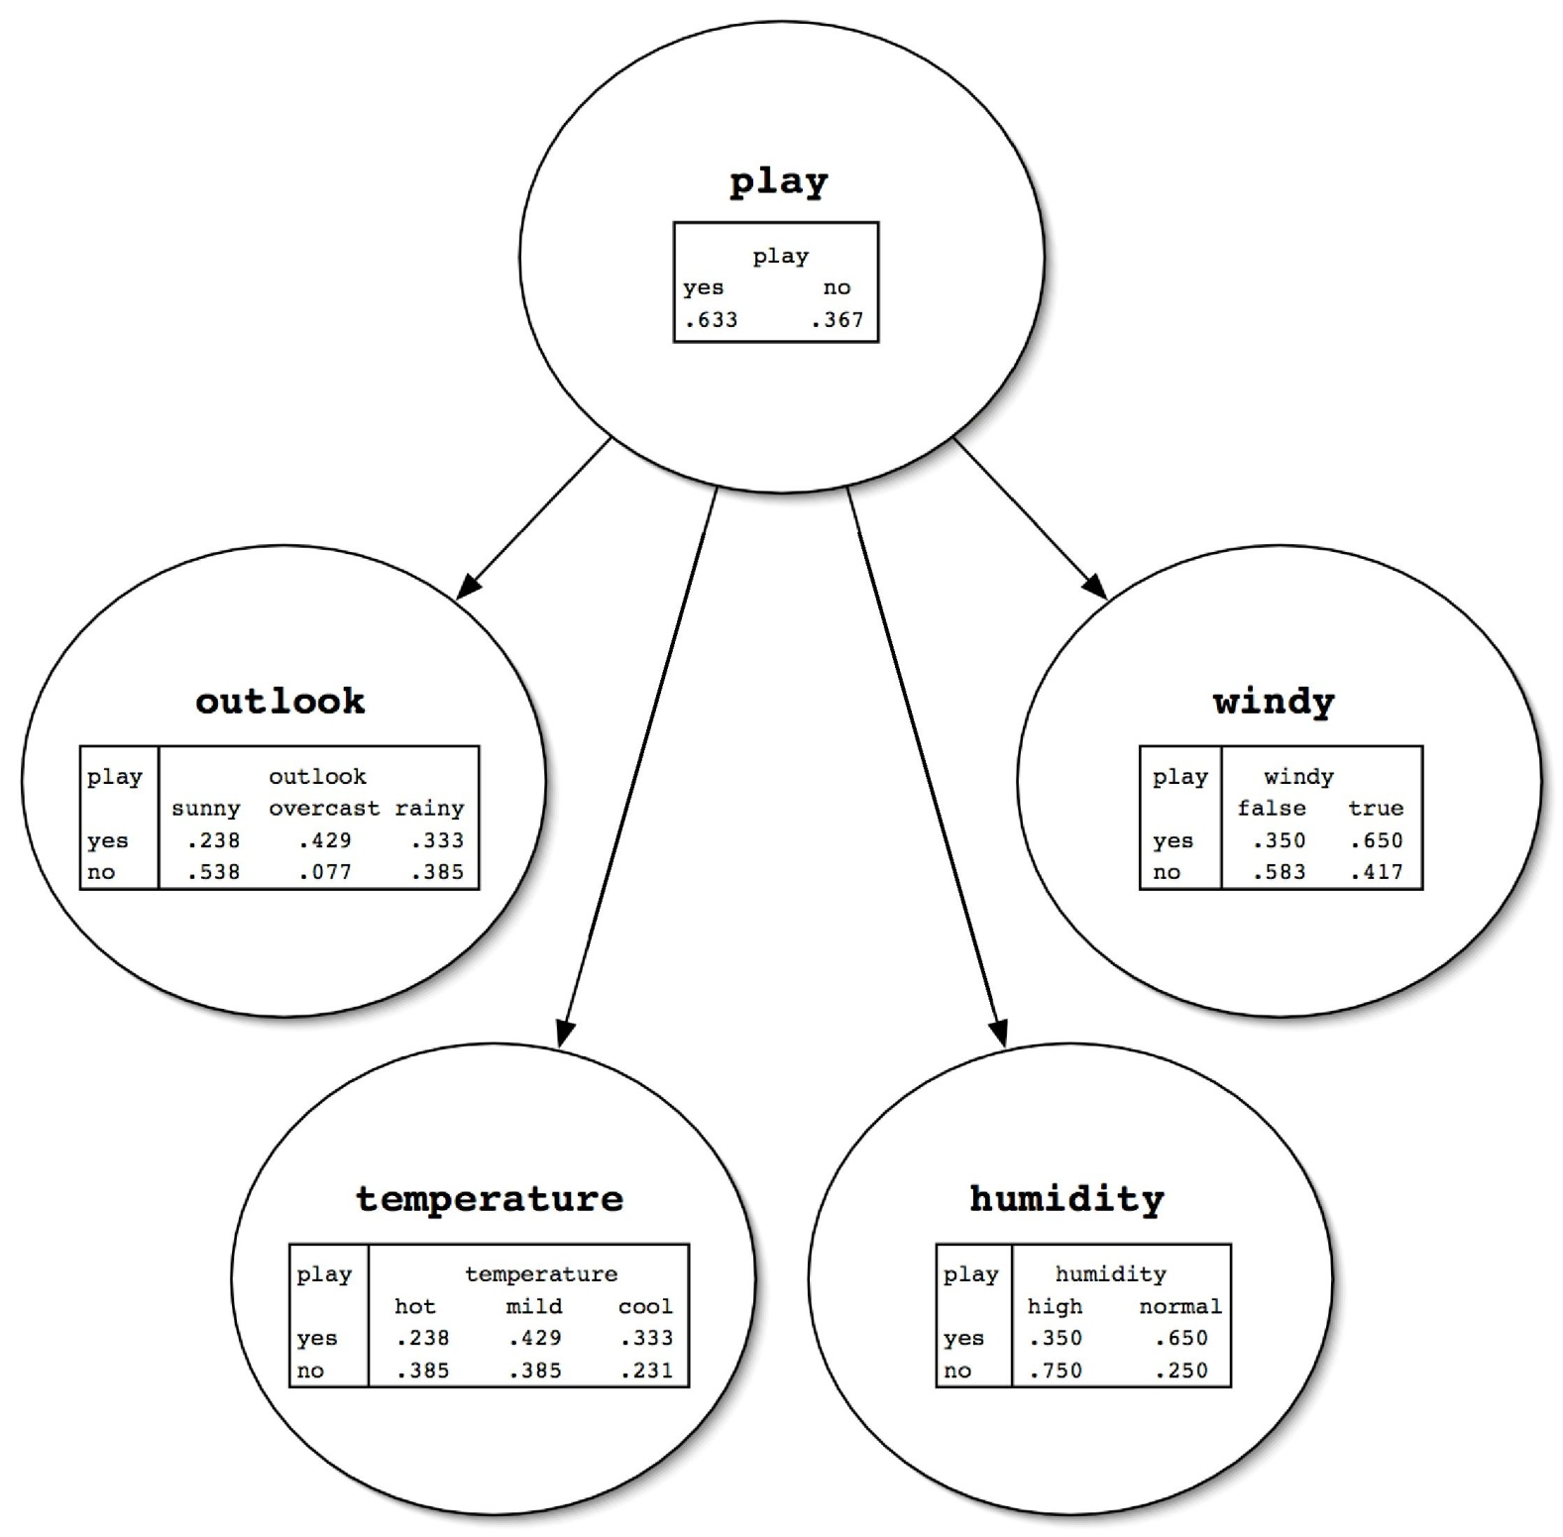
Weather data
80

Slide 81
Bayesian networks
Graphical models that can represent any probability distribution
Graphical representation:
directed
acyclic graph,
one node for each attribute
Overall probability distribution factorized into conditional distributions
Graph’s nodes hold conditional distributions
81

Slide 82
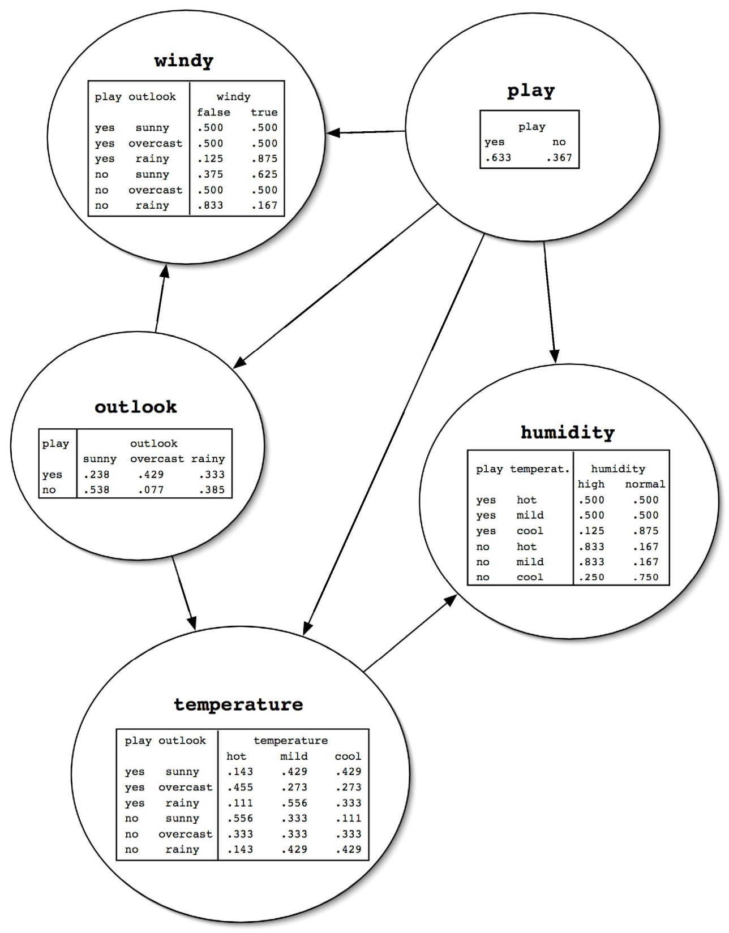
Weather data
82

Slide 83
Causality – be cautious!
Discussions on causality on solid mathematical basis
Distinguishing causation from correlation?
Sometimes…
At least three variables
One of the variables: „virtual control” for the relationship between the other two

Slide 84
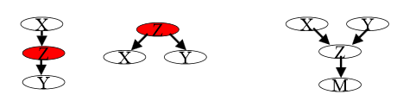
(d-separation)
Nodes X and Y are d-separated if on any (undirected) path between X and Y there is some variable Z such that is either
Z is in a serial or diverging connection and Z is known, or
Z is in a converging connection and neither Z nor any of Z’s descendants are known
Nodes X and Y are called d-connected if they are not d-separated (there exists an undirected path between X and Y not d-separated by any node or a set of nodes)
If nodes X and Y are d-separated by Z, then X and Y are conditionally independent given Z

Slide 85
Prediction: Computing the class probabilities
Two steps:
computing a product of probabilities for each class
For each class value
Take all attribute values and class value
Look up corresponding entries in conditional probability distribution tables
Take the product of all probabilities
normalization
Divide the product for each class by the sum of the products

Slide 86
Why can we do this? (Part I)
Single assumption: values of a node’s parents completely determine probability distribution for current node
Means that node/attribute is conditionally independent of other ancestors given parents

Slide 87
Why can we do this? (Part II)
Chain rule from probability theory:
Because of our assumption from the previous slide:

Slide 88
Learning Bayesian Networks
Known structure, full observability:
Maximum likelihood estimation
Unknown structure, full observability:
Search through model space
(Known structure, partial observability)
(Unknown structure, partial observability)

Slide 89
Known structure, full observability
Conditional probability distributions for parameters, maximising the likelihood of the training data
Log likelihood: decomposes according to the structure maximising node by node
Counting (for nominal distribution), Gaussian: mean + variance

Slide 90
Unknown structure, full observability
Method for evaluating the goodness of a given network
Log-likelihood
Searching for a good network (structure)
I.e. searching through sets of edges because nodes are fixed

Slide 91
Goodness of given network
Maximizing (log-)likelihood of training data
However, addig more edges improves this, as it fits the training data more closely
Overfitting has to be avoided!

Slide 92
Avoiding overfitting
Cross-validation or
Penalty for complexity of the network
AIC (Akaike Information Criterion) measure: AICscore = - LL + K
MDL (Minimum Description Length) measure: MDLscore = -LL + K/2 log N
LL: log-likelihood (log of probability of data), K: number of free parameters, N: #instances

Slide 93
Searching for a good structure
NP-hard
(4 nodes: 453 dags; 10 nodes O(10E18) dags)
If ordering of nodes given: simpler
Learning parent set per node, independently (score, also AIC and MDL decomposable)
Can optimize node by adding or removing edges from other nodes

Slide 94
The K2 algorithm
Starts with given ordering of nodes (attributes)
Processes each node in turn
Greedily tries adding edges from previous nodes to current node
Moves to next node when current node can’t be optimized further
Result depends on initial order

Slide 95
The K2 algorithm
A
B
C
D
E
Notes:
Initial order!
Additional measure to avoid overfitting: upper limit for the number of parents of each node

Slide 96
Other algorithms
Extending K2
no preset order of nodes
greedily adding or deleting edges between any pair of nodes
further step: considering inverting the direction of edges
TAN (Tree Augmented Naïve Bayes):
Starts with naïve Bayes
Considers adding second parent to each node (apart from class node)
Efficient algorithm exists

Slide 97
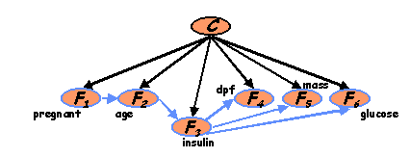
TAN - Example
One-dependence estimator

Slide 98
TAN – Special case
Superparent one-dependence estimator
A
B
C
D
E

Slide 99
(Data structures for fast learning)
Learning Bayes nets involves a lot of counting for computing conditional probabilities
Naïve strategy for storing counts: hash table
Runs into memory problems very quickly
More sophisticated strategy: all-dimensions (AD) tree
Analogous to kD-tree for numeric data
Counts in tree
Redundancy is eliminated
Only makes sense to use it for large datasets

Slide 100
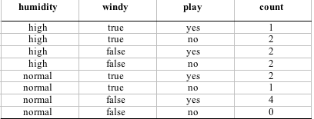
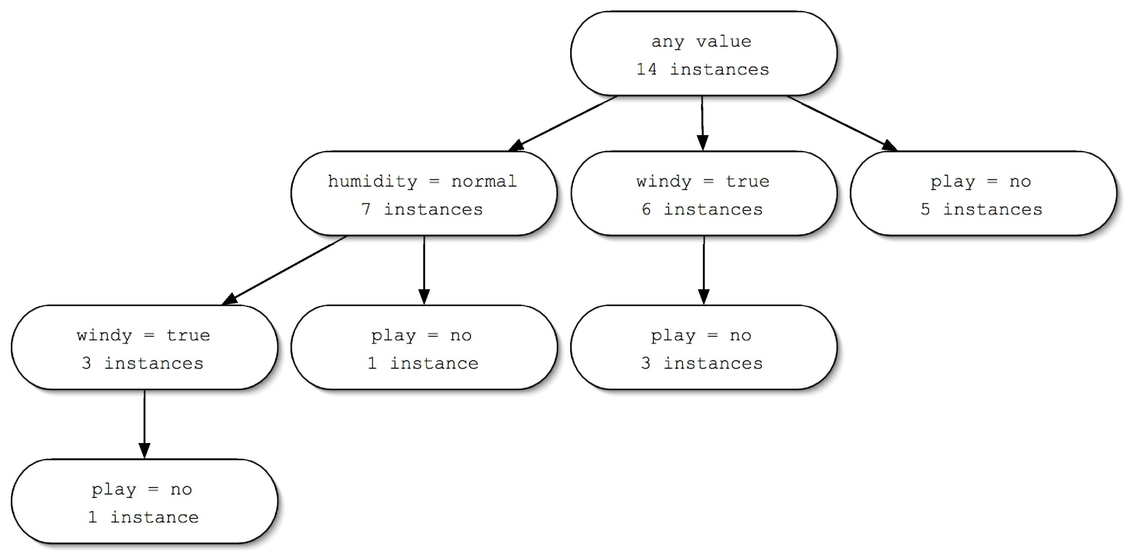
(AD tree example)
1
2
3
0
1
2
3
2
3
3
3
100

Slide 101
Clustering

Slide 102

K-Means
Example: k = 2
http://syskall.com/kmeans.js/

Slide 103
K-Means
Number of clusters ?
Minimizes within-cluster sum-of-squares (inertia). Good for clusters that are
convex
isotropic (all directions are uniform)
High dimensional spaces?
Curse of dimensionality
Principal Component Analysis
103

Slide 104
K-Means Number of Clusters/1
K=1, …n (small)
minimizing total squared distance to cluster centers
penalizing solutions with many clusters (eg. using an MDL criterion)

Slide 105

K-Means Number of Clusters/1 Recursive k-means
k-means (k = 2) recursively
seeds for subclusters can be chosen by seeding along direction of greatest variance in cluster (one standard deviation away in each direction from cluster center of parent cluster)
use stopping criterion (eg. MDL)
X-means algorithm (using Bayesian Information Criterion instead of MDL)
Hierarchical clusters (top-down)

Slide 106
K-Means Scaling
Scaling
Goal: reduce computation time, without affecting quality too much
Mini-batch
Randomly sampled subset of the data
106

Slide 107

Mean-Shift
Sliding-window, for finding dense areas of instances
Centroid-based: center points of instances within sliding window
Shift towards regions of higher density (mean of points in the window)
Stop when density can’t be increased

Slide 108

Mean-Shift/2
Many sliding windows
All points lie within a window
Overlapping windows merged
Automatically sets number of clusters

Slide 109
Mean-shift/3
Many clusters
Uneven cluster size
Scalability bad

Slide 110

Density-based clustering

Slide 111
DBSCAN: Density-Based Spatial Clustering of Applications with Noise
Arbitrary starting point (not yet visited)
Neighborhood (epsilon)
Point: marked as visited
If sufficient number of points (minPoints):
clustering process starts
For all points in neighborhood repeat step
Otherwise: noise
New unvisited point ….

Slide 112

DBSCAN / 2

Slide 113
DBSCAN / 3
Arbitrarily sized and shaped clusters
Number of clusters flexible
Outliers identified as noise
Clustes of varying density?

Slide 114
Probability-based clustering
instance belongs to a particular cluster with a certain probability
Probabilistic perspective ⇒ seek the most likely clusters given the data
Finite mixtures
Model data using a mixture of distributions
One cluster, one distribution
governs probabilities of attribute values in that cluster
Finite mixtures : finite number of clusters
Individual distributions are normal (usually)
114

Slide 115

Gaussian Mixture Model (GMM)
(probability that instance x belongs to cluster A….)
115

Slide 116
Expectation–Maximization (EM) Clustering using GMM
EM = Expectation-Maximization
Generalize k-means to probabilistic setting
Iterative procedure:
E “expectation” step: Calculate cluster probability for each instance (improving mapping of instances to clusters)
M “maximization” step: Estimate distribution parameters from cluster probabilities (adopting, improving clusters) probability of training data given the clusters
Stop when improvement is negligible
finds a local maximum of the likelihood
116

Slide 117

EM Clustering using GMM

Slide 118
Hierarchical clustering
Top-down:
recursively splitting up large clusters into smaller ones e.g. recursive k-means
Bottom-up (hierarchical agglomerative clustering):
Each instance as a single cluster
Successvely merge (agglomerate) pairs of clusters
118

Slide 119
Agglomerative clustering (bottom-up)
Simple algorithm
Requires a distance/similarity measure
Start by considering each instance to be a cluster
Find the two closest clusters and merge them
Continue merging until only one cluster is left
The record of mergings forms a hierarchical clustering structure

Slide 120


Example hierarchical clustering
50 examples of different creatures from the zoo data
1 numeric attribute (number of legs: 0-6 scaled to 0-1)
15 Boolean attributes (has feathers, lays eggs,…)
Dendogram
Height of each node in the dendogram can be made proportional to the dissimilarity between its children
120
Dendogram

Slide 121

Distance measures
Single linkage (minimum distance)
outliers?!
Complete linkage (maximum distance)
outliers?!
Average linkage
a lot of calculations!
Centroid (mean) linkage
For compact and well separated clusters – not much difference

Slide 122

Python, sci-kit learn, clustering methods overview (http://scikit-learn.org/stable/modules/clustering.html)

Slide 123
Clustering …
Iterative clustering
Quality measures for clustering
Clustering nodes in a graph

Slide 124
Combining clustering and classification

Slide 125
Semisupervised learning
Semisupervised learning: attempts to use unlabeled data as well as labeled data
The aim is to improve classification performance
Why try to do this? Unlabeled data is often plentiful and labeling data can be expensive
Web mining: classifying web pages
Text mining: identifying names in text
Video mining: classifying people in the news
Leveraging the large pool of unlabeled examples would be very attractive

Slide 126



Labelling data is expensive! Crowdsourcing (Appen, Amazon Mechanical Turk, Figure Eight,…)
Fun staff with Hungarian connection:The Turk, Farkas Kempelen (https://en.wikipedia.org/wiki/The_Turk)

Slide 127
Clustering + classification
Classification problem
Possible to train classifier directly
Improving classifier
Clustering first
Groups similar instances
Including cluster value as new attribute

Slide 128
Summary/concepts/questions
Overfitting, underfitting
C4.5
Handling of numeric attributes
Handling of missing values (learning, classification)
Pruning
pre-pruning, post-pruning (subtree replacement, subtree raising)
Error estimation
Reduced Error Pruning
CART
GINI Index
Cost-complexitiy pruning
Regularized linear regression
Ridge
Lasso
Regression tree learning
Model tree learning
Smoothing

Slide 129
Summary/concepts/questions 2
Instance based learning
performance
noise
attribute weighing and selection
generalisation
Bayesian networks
d-separation
Prediction with Bayesian network
Learning Bayesian Networks
Known structure, full observability
Unknown structure, full observability
Evaluating the goodness of a given network (maximum likelihood + preventing overfitting (AIC, MDL)
Searching through space of possible networks (K2, TAN, Superparent one-dependence estimator)
Support Vector Machine
Maximum margin hyperplane
nonlinear case, Kernel function
Regularization parameter

Slide 130
Summary/concepts/questions 3
clustering
K-Means
Mean-shift
DBSCAN (density-based)
EM Clustering using GMM (probabilistic)
Hierarchical
Top-down
Bottom-up (agglomerative)
Semisupervised learning

